Slide 1
DataSpark: Illuminating Insights for Global Electronics
Presented By:
Vijayalakshmi

Slide 2
Executive Summary
Project overview
The objective of DataSpark is to provide advanced data analytics solutions to electronics companies by analysing their retail data. The platform uses real-time insights to enhance decision-making, optimize inventory, improve customer targeting, and forecast trends within the electronics sector. The primary goal is to empower retail managers, product managers, and business analysts with actionable insights that drive sales and improve operational efficiency.

Slide 3
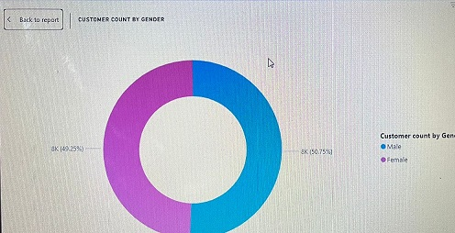
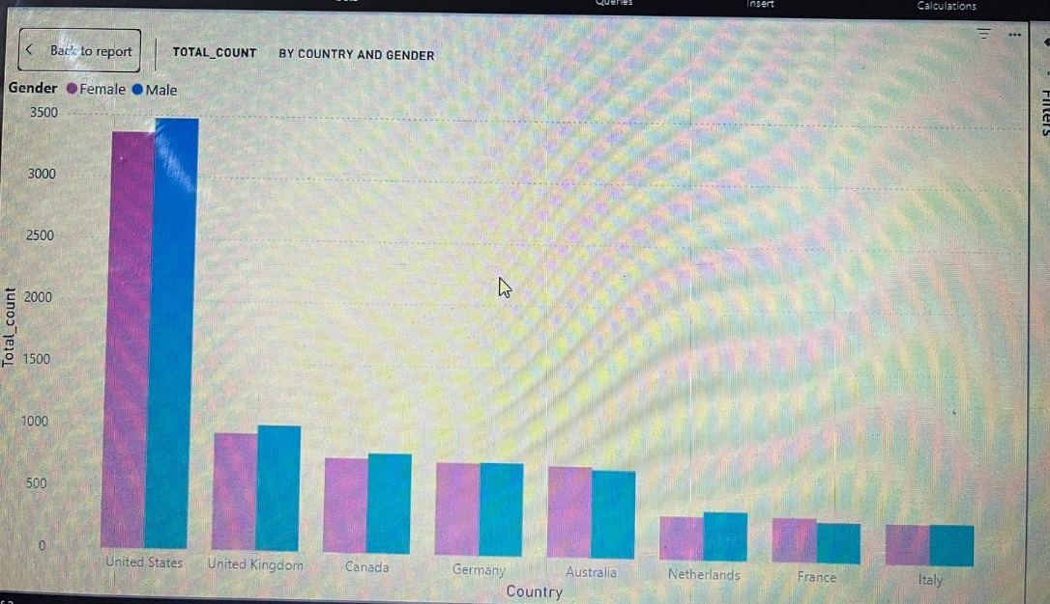
Analysis and Insights
Customer Analysis gender wise
The data indicates that male customers significantly outnumber the female customers with a slight difference, by Targeting advertisements aimed at women could help address this imbalance and boost overall sales.
Customer Analysis Country wise
United States customer dominance is higher compared to United Kingdom, Canada, Germany and Australia. Least Customers were from Netherlands, France and Italy.
Collaborating with local influencers, local brands and by conducting competitive analysis to adopt some strategies we can enhance customer acquisition.

Slide 4
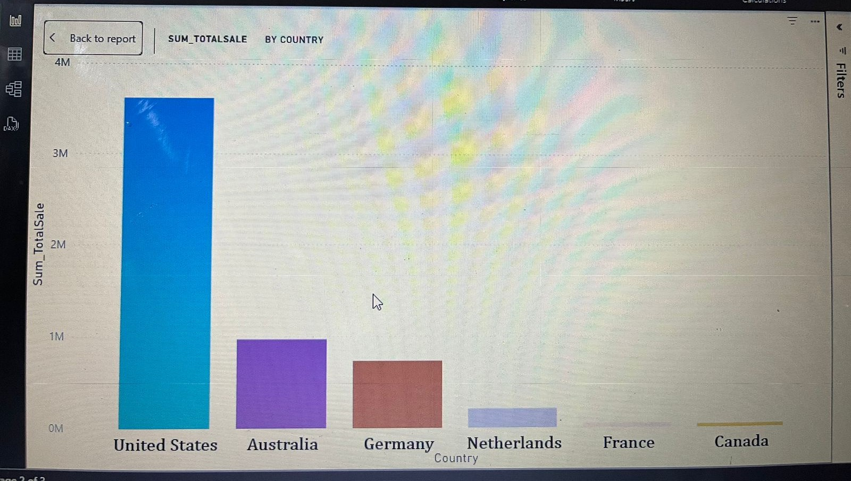
Analysis of total sale of each Country
United States customer dominance is higher compared to United Kingdom, Canada, Germany and Australia. Least Customers were from Netherlands, France and Italy.
Using this Analysis ,we can take measures to improve the sale in other countrys .

Slide 5
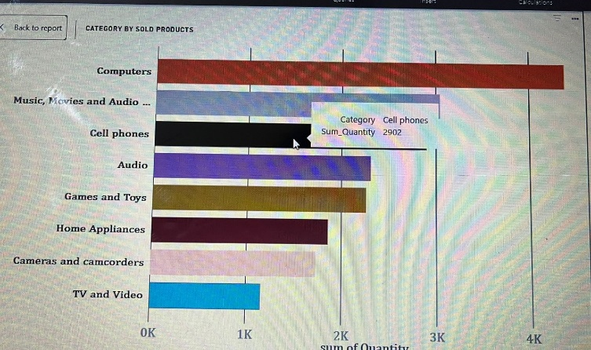
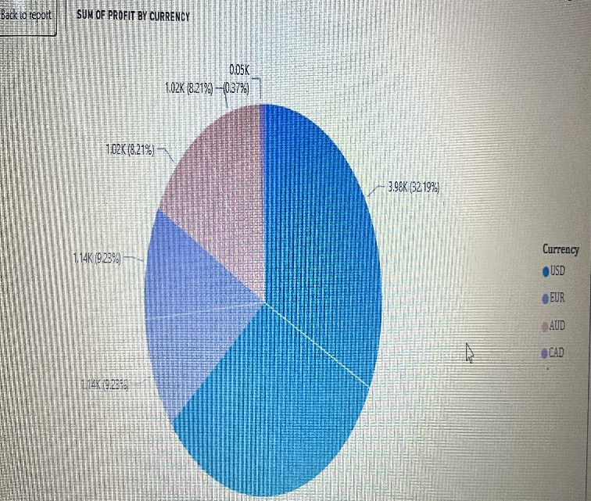
Sales Analysis by Category
Computers were the top category by the Quantity sold, Tv and video were the least sold. Ensure adequate stock levels for high demand categories and create a bundles of combining high performing items with low performing items, also offering discounts on low performing will boost sales across categories.
Sales Analysis by Currency
Sum of profit for USD currency was 64.38% , followed by:
EUR: 18.46%
AUD: 16.42%
CAD: 0.37%
Profit on USD currency was higher compared to other currency. Use currency optimization Strategy like monitoring fluctuations in exchange rate and adjusting local pricing based on the strength of currency to maintain profitability

Slide 6
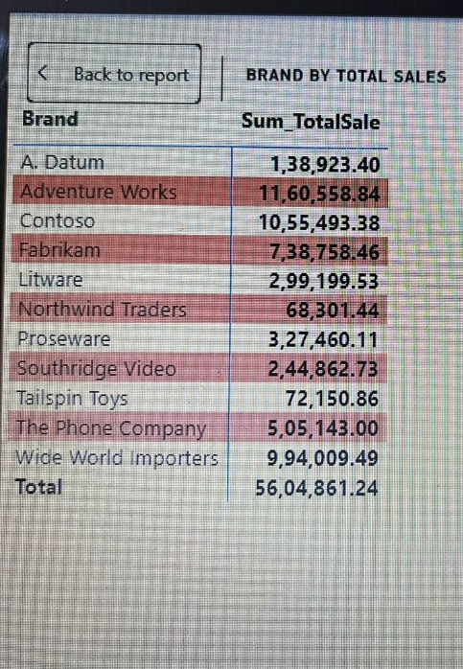
Sales analysis by brands
Top performing brand was Adventure Works by its total sales followed by Contoso and the least was Northwind Traders.
If customers are drawn into fewer top brands, consider diversifying the product lineup to reduce dependency .

Slide 7
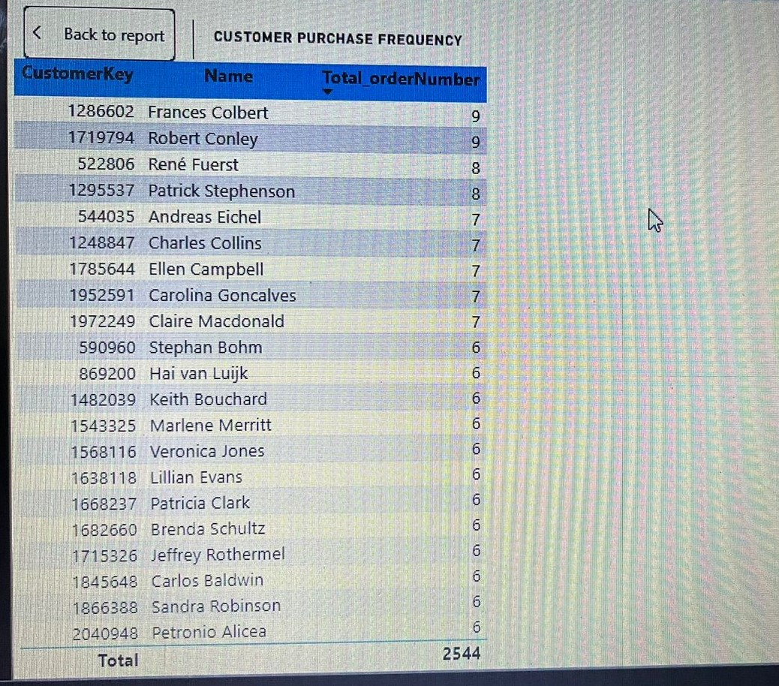
Customer Purchase Frequency
Analyzing the Frequency of Same Customer Purchasing the Products ,So that we Can generate a report on Regular Customers and the products the have purchased, so that we can get a feedback regarding the products and it will be useful for developing the sale of the particular brand and can be helpful for improving the Marketing of the store.
We can Consider offering some Discounts for the Premium Customers

Slide 8
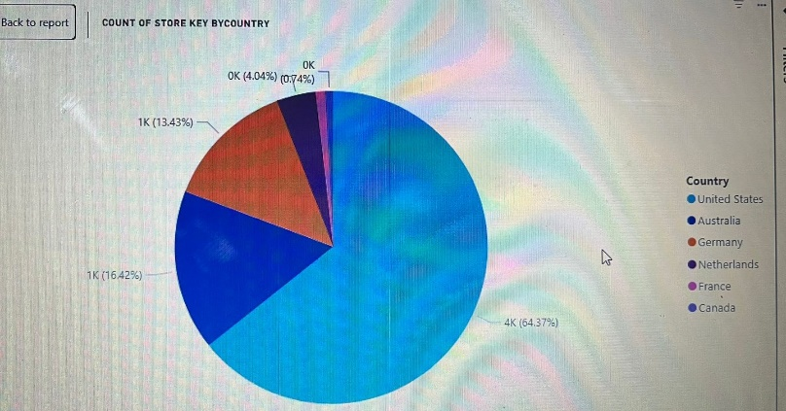
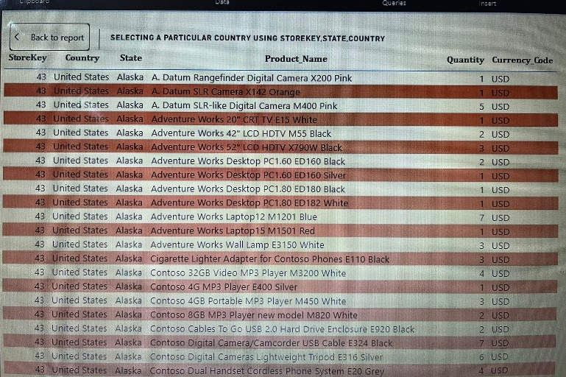
Store analysis by country and sales
US has high no of stores by 64.37% compared to Australia with 16.4% . Stores with Store Key “5” contribute to the highest sales and revenue
For countries like France and Canada with less no of stores consider setting up pop up stores in strategic locations such as busy shopping places. In countries with fewer stores Franchising could be of low risk to improve business growth
Analysing a Particular Country using store key Value ,So that we can create a Data regarding the Total products that are sold ,which is faster moving Brand, product etc. and the least one so that we can improve the sales of the particular brand and product, from each state etc.

